Slide 1
Exploring football data using Clojure and friends
@markhneedham

Slide 2
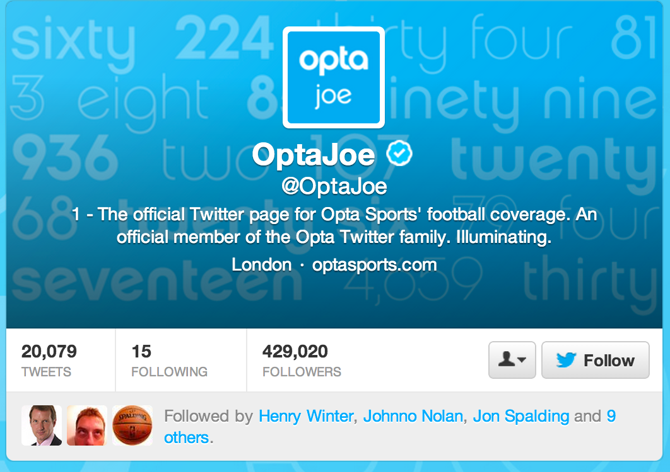
It all started with Joe

Slide 3

I can haz data?
I asked nicely!

Slide 4

No
☹

Slide 5

The Data Science Motto
Notes:
The Data Science Motto

Slide 6

Before we start scraping
Notes:
It’s easy to get carried away when you get into scraping mode so from my foolishness I’ve come up with a few observations to save you time

Slide 7


Don’t build a crawler
Notes:
Investigate URI structure for a bit – avoid writing a crawler if you can – it is paiiiiin

Slide 8

Download files to disk
Notes:
Don’t scrape live – download it to disk -> you will forget to get something and it’s painful having to go over the network next time

Slide 9
$ head –n 3 uris.txt
http://www.premierleague.com/en-gb/matchday/league-table.html?season=1992-1993
http://www.premierleague.com/en-gb/matchday/league-table.html?season=1993-1994
http://www.premierleague.com/en-gb/matchday/league-table.html?season=1994-1995
$ cat uris.txt |
xargs -P5 -Iuri wget uri
wget is your friend
Notes:
Use wget – it’s awesome – get a list of files and give it to wget & xargs

Slide 10
(def base-uri
"http://www.premierleague.com/en-gb/matchday/league-table.html?season=")
(doseq [season
(map (fn [[y1 y2]]
(str base-uri y1 "-" y2 ))
(zipmap (range 1992 2013)
(range 1993 2014)) )]
(println season))
wget is your friend
Notes:
Use wget – it’s awesome – get a list of files and give it to wget & xargs

Slide 11
Find
Download
Extract
My Data work flow
Notes:
I try to use this work flow for data work – separate the steps, don’t mash them together. Then you can do them in different languages

Slide 12
By hand/Clojure
wget
Clojure
My Data work flow
Notes:
I try to use this work flow for data work – separate the steps, don’t mash them together. Then you can do them in different languagse

Slide 13

Clojure + Enlive + emacs + nrepl = #win

Slide 14
Clojure – A JVM based LISP dialect
Enlive – A selector based templating library
nrepl – A Clojure REPL
Emacs – an editor with nrepl integration
What are they?

Slide 15
(ns ranking-algorithms.uefa
(:use [net.cgrand.enlive-html]))
(defn fetch-page
[file-path]
(html-resource
(java.io.StringReader. (slurp file-path)))) (defn extract-rows [page]
(select page [:table :tbody]))
A brief introduction to Enlive

Slide 16
> (->> "data/uefa/2013/_matchesbydate.html.0"
fetch-page
extract-rows)
({:tag :tbody, :attrs {:class "tb_2009399"}, :content ({:tag :tr, :attrs {:id "sup_2009399", :class "sup"}, :content ({:tag :td, :attrs {:class "status nob", :colspan "5"}, :content ({:tag :div, :attrs {:class "sup-left l"}, :content ({:tag :span, :attrs {:class "b dateT"}, :content ("3 July 2012 ")} {:tag :span, :attrs {:class "sep"}, :content ("- ")} {:tag :span, :attrs {:class "rname"}, :content ({:tag :a, :attrs {:href "/uefachampionsleague/season=2013/matches/round=2000343/index.html"}, :content ("First qualifying round")})})} {:tag :div, :attrs {:class "sup-right r b"}, :content ({:tag :span, :attrs {:class "report"}, :content ({:tag :a, :attrs {:class "mr", :href "/uefachampionsleague/season=2013/matches/round=2000343/match=2009399/index.html"},
A brief introduction to Enlive
Notes:
Make use of the threading operator when exploring the data – apply various functions over the data to get what we want from the page

Slide 17
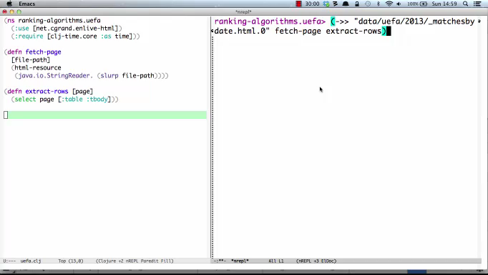
Now let’s extract the bits we care about

Slide 18
(defn extract-content [match]
(let [score
(cleanup (first (:content (first (select match [:tr :td.score :a])))))
home
(cleanup (first (:content (first (select match [:tr :td.home :a])))))
away
(cleanup (first (:content (first (select match [:tr :td.away :a])))))
round
(cleanup (first (:content (first (select match [:span.rname :a])))))
date
(as-date (cleanup (first (:content (first (select match [:span.dateT]))))))]
{:home home
:away away
:home_score (read-string (nth (clojure.string/split score #"-") 0))
:away_score (read-string (nth (clojure.string/split score #"-") 1))
:round round
:date date}))
A brief introduction to Enlive
Notes:
Make use of the threading operator when exploring the data – apply various functions over the data to get what we want from the page

Slide 19
Premier League Matches
Stadiums
Players
Champions League Matches
TV Games
All the data
Notes:
I’ve collected a bunch of different data using different tools, iterating the approach along the way.
Imported data using Ruby/Java – web driver & nokogiri & mechanize

Slide 20

Premier League Matches
Stadiums
Players
Champions League Matches
TV Games
Modeling with graphs
Notes:
At the time I hadn’t done much stuff with graphs but I’d read that they were very good for modeling data with lots of dimensions so I thought I’d try it out
I’m using neo4j but there are other graph databases around

Slide 21
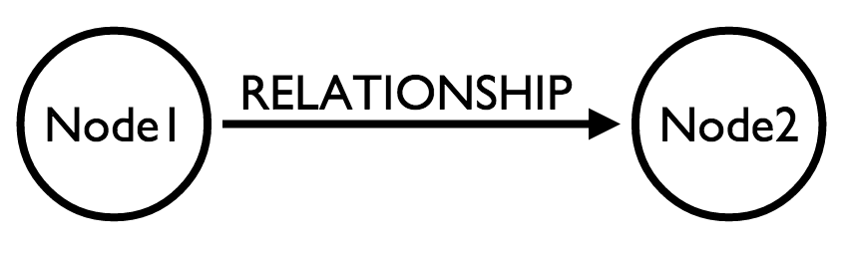
Modeling with graphs

Slide 22
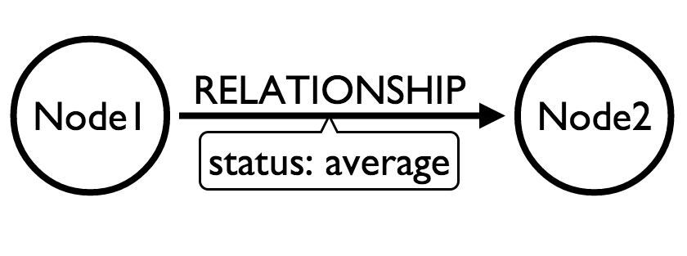
Modeling with graphs

Slide 23
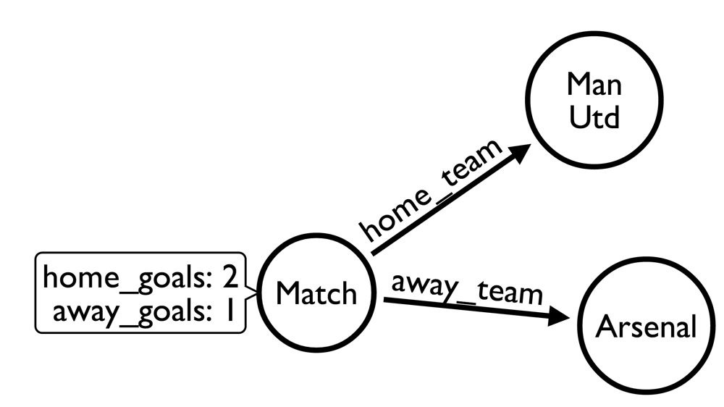
Modeling football

Slide 24
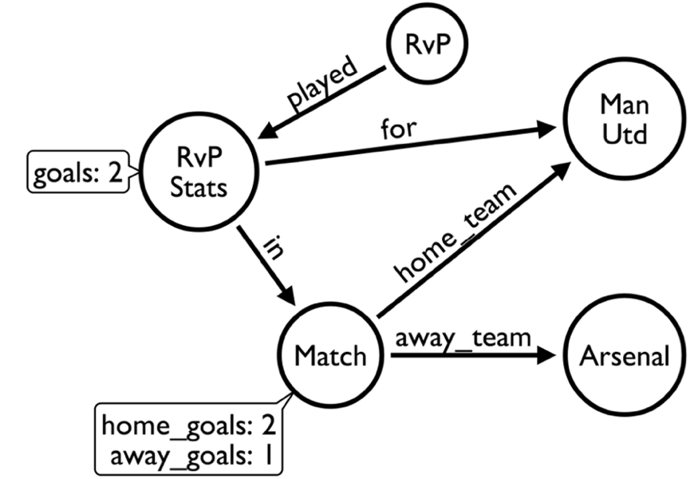
Modeling football

Slide 25
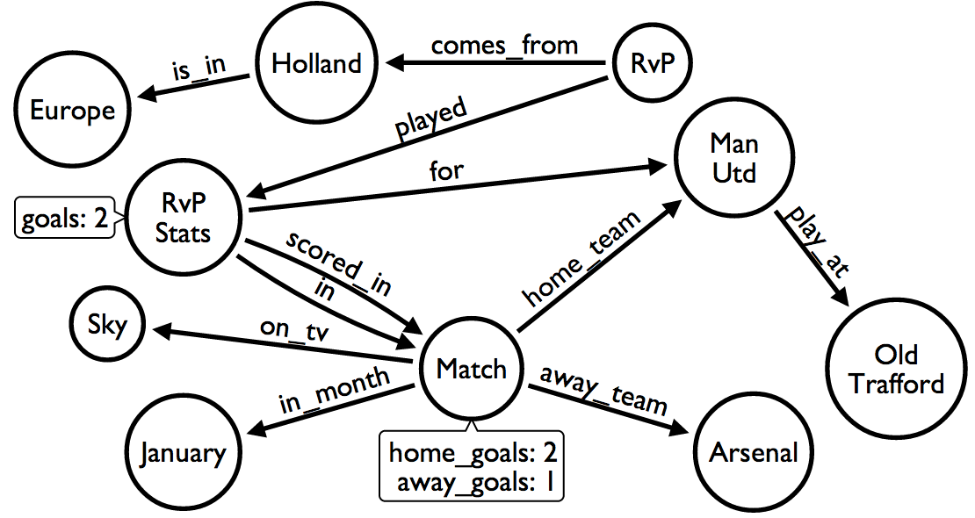
Modeling football

Slide 26
Graph query language for neo4j
Inspired by SQL & SPARQL
Declarative
Humane
Features ASCII art
Querying using cypher

Slide 27
START: Starting points in the graph, obtained via index lookups or by element IDs.
MATCH: The graph pattern to match, bound to the starting points in START.
WHERE: Filtering criteria.
RETURN: What to return.
Some keywords we’ll care about

Slide 28
START player = node:players('name:*')
MATCH player-[:played]->stats
RETURN player.name,
SUM(stats.goals) AS goals
ORDER BY goals DESC
LIMIT 10
Finding the top scorer
Notes:
We do an index lookup to find all the players
Then we follow the ‘played’ relationship from a player to find their performance in matches
Then we return the player and add up any goals they scored

Slide 29
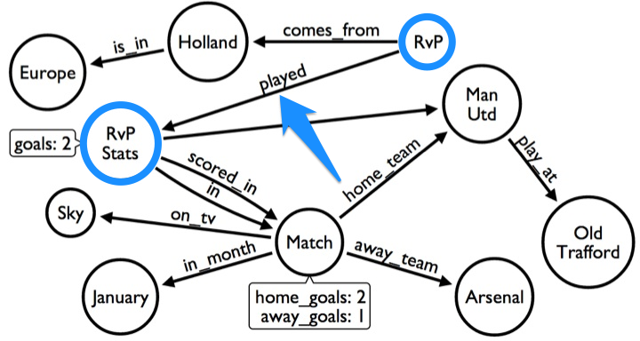
Finding the top scorer

Slide 30
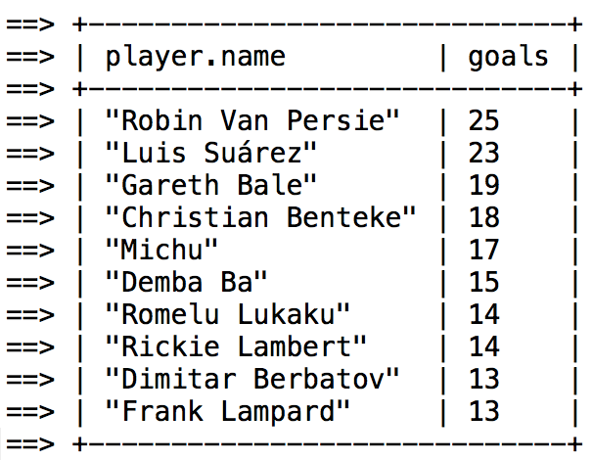
Finding the top scorer

Slide 31
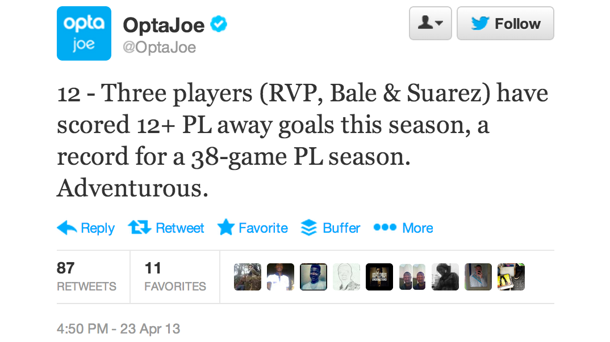
Find the top scorer away from home
Notes:
Attempting to match Opta

Slide 32
START player = node:players('name:*')
MATCH player-[:played]-stats-[:in]-game,
stats-[:for]-team
WHERE game-[:away_team]-team
RETURN player.name,
SUM(stats.goals) AS goals
ORDER BY goals DESC
LIMIT 10
Find the top scorer away from home
Notes:
Attempting to match Opta

Slide 33
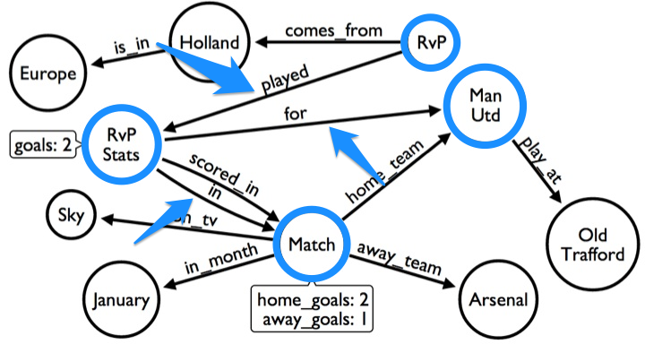
Find the top scorer away from home
Notes:
Attempting to match Opta

Slide 34
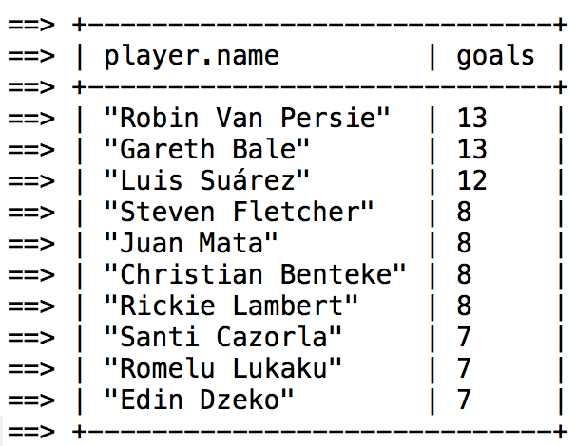
Find the top scorer away from home
Notes:
Attempting to match Opta

Slide 35
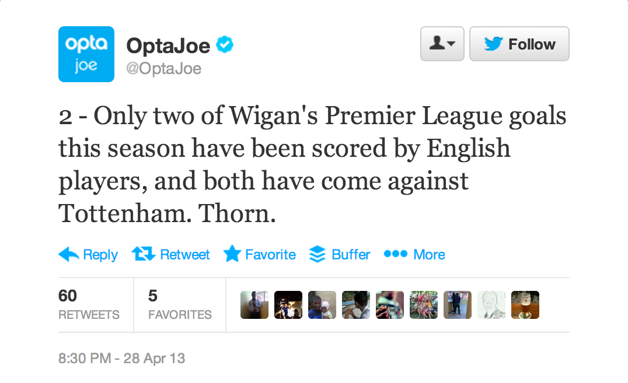
Find Wigan’s English scorers
Notes:
Now we have one which requires us to take the player’s nationality into account

Slide 36
START team = node:teams('name:"Wigan"'),
country=node:countries('name:"England"')
MATCH player-[:comes_from]->country,
team-[:home_team|away_team]->game,
game<-[:in]-stats-[:for]->team,
stats<-[:played]-player-[:scored_in]->game,
game<-[:home_team|away_team]-opposition
RETURN player.name AS name,
opposition.name AS opposition,
game.friendly_date AS date
Find Wigan’s English scorers
Notes:
Attempting to match Opta

Slide 37
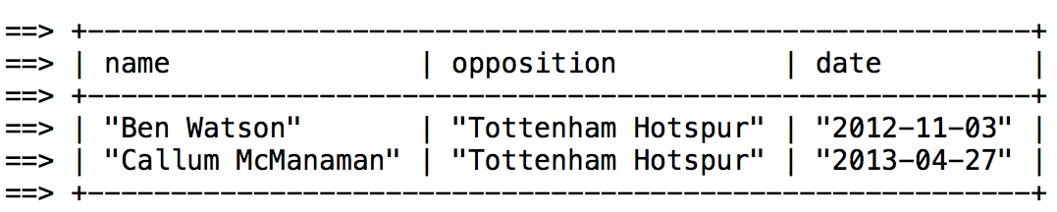
Find Wigan’s English scorers
Notes:
Attempting to match Opta

Slide 38

Ranking Systems
Notes:
I started to have some questions which I thought should be based on team rankings: do players only score against rubbish teams? Who’s actually the best team in the Champions League for a given season

Slide 39
Everyone plays everyone
vs.
Teams play a selection of other teams
Does everyone play everyone?
Notes:
If all the teams play each other then it’s fair to say that the team that finishes in first is the best one e.g. league competitions. We can then take the final position as a reasonable indicator of the team’s skill.

Slide 40
A human decides part of the ranking
vs.
Use statistical basis to come up with a model
Subjective vs Objective Rankings
Notes:
Objective vs Subjective Rankings
- In competitions where everybody doesn’t play everybody else it’s a different story and there are different approaches we can take
Subjective – a human decides part of the ranking
e.g. UEFA coefficient – give points for each round
Objective – use statistical basis to come up with a model for rankings

Slide 41
UEFA coefficient
ATP Tennis Rankings
WTA Tennis Rankings
World Golf Rankings
Bowl Championship Series
Subjective Ranking Systems
Notes:
e.g. UEFA coefficient – give points for each round and add country coefficient too.
ATP Tennis – someone decides the importance of different tournaments and points are assigned appropriately
http://www.lifewithalacrity.com/2006/01/ranking_systems.html

Slide 42
“
The Elo rating system is a method for calculating the relative skill levels of players in competitor-versus-competitor games.
”
Elo Rating System
Notes:
The Elo Rating System
Most famously used in chess
Takes into account the importance of the match and the probability that each team will win

Slide 43
R' = R + K * (S - E)
R' is the new rating
R is the old rating
K is a maximum value for increase or decrease of rating (16 or 32 for ELO)
S is the score for a game
E is the expected score for a game
E(A) = 1 / [ 1 + 10 ^ ( [R(B) - R(A)] / 400 ) ]
E(B) = 1 / [ 1 + 10 ^ ( [R(A) - R(B)] / 400 ) ]
Elo Rating System
Notes:
Based on probabilities of wins – if you’re expected to win and you lose then you get penalised quite heavily
Elo's central assumption was that the chess performance of each player in each game is a normally distributed random variable.
A 200 point rating difference means a player has a 75% chance of winning

Slide 44
R(A) = 1900
R(B) = 1500
E(A) = 1 / [ 1 + 10 ^ ( [1500 - 1900] / 400 ) ]
= 1 / [ 1 + 10 ^ ( -400 / 400) ]
= 1 / [ 1 + 10 ^ -1 ]
= 1 / 1 + .1
= .91 / 91%
E(B) = 1 / [ 1 + 10 ^ ( [1900 - 1500] / 400) ]
= 1 / [ 1 + 10 ^ ( 400 / 400 ) ]
= 1 / [ 1 + 10 ^ 1 ]
= 1 / 11
= .09 / 9%
An example
Notes:
Based on probabilities of wins – if you’re expected to win and you lose then you get penalised quite heavily

Slide 45
If we win:
R' = 1900 + 32 * (1 - .91)
R' = 1900 + 32 * .09
R' = 1900 + 2.88
R' = 1903
If we lose:
R' = 1900 + 32 * (0 - .91)
R' = 1900 - 29.12
R' = 1871
An example
Notes:
You don’t gain much if you win, but you lose a lot if you lose

Slide 46
(defn expected [my-ranking opponent-ranking]
(/ 1.0
(+ 1
(math/expt 10 (/ (- opponent-ranking my-ranking) 400)))))
(defn ranking-after-game
[{ ranking :ranking
opponent-ranking :opponent-ranking
importance :importance
score :score}]
(+ ranking
(* importance
(- score (expected ranking opponent-ranking)))))
(defn ranking-after-win [args]
(ranking-after-game (merge args {:score 1})))
(defn ranking-after-win [args]
(ranking-after-game (merge args {:score 0})))
(defn ranking-after-draw [args]
(ranking-after-game (merge args {:score 0.5})))
The algorithm in code
Notes:
This is what the code looks like

Slide 47
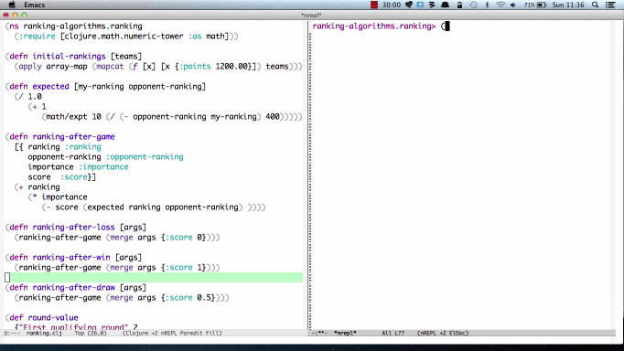
The Code in action
Notes:
This is what the code looks like

Slide 48
Get all the matches
Extract teams from matches
Set initial rankings for teams
Process each match updating rankings as we go
Wiring it all together
Notes:
This is what the code looks like

Slide 49
(->> file fetch-page extract-rows
(map extract-content))
(set (mapcat extract-teams matches))
(map add-ranking teams)
(reduce process-match teams matches)
Wiring it all together
Notes:
This is what the code looks like

Slide 50
(defn process-match [ts match]
(let [{:keys [home away home_score away_score round]} match]
(cond
(> home_score away_score)
(-> ts
(update-in [home :points]
#(ranking-after-win {:ranking %
:opponent-ranking (:points (get ts away))
:importance (get round-value round 32)}))
(update-in [away :points]
#(ranking-after-loss {:ranking %
:opponent-ranking (:points (get ts home))
:importance (get round-value round 32)})))
(> away_score home_score)
(-> ts
(update-in [home :points]
#(ranking-after-loss {:ranking %
:opponent-ranking (:points (get ts away))
:importance (get round-value round 32)}))
(update-in [away :points]
#(ranking-after-win {:ranking %
:opponent-ranking (:points (get ts home))
:importance (get round-value round 32)})))
(= home_score away_score)
(-> ts
(update-in [home :points]
#(ranking-after-draw {:ranking %
:opponent-ranking (:points (get ts away))
:importance (get round-value round 32)}))
(update-in [away :points]
#(ranking-after-draw {:ranking %
:opponent-ranking (:points (get ts home))
:importance (get round-value round 32)}))))))
Wiring it all together
Notes:
This is what the code looks like

Slide 51
> (def ts { "Manchester United" {:points 1900.00}, "Manchester City" {:points 1500.00}})
> (def match {:home "Manchester United"
:away "Manchester City"
:home_score 2
:away_score 1
:round "Final"})
> (process-match ts match)
{ "Manchester United" {:points 1902.909090909091}, "Manchester City" {:points 1497.090909090909}}
Wiring it all together
Notes:
This is what the code looks like

Slide 52
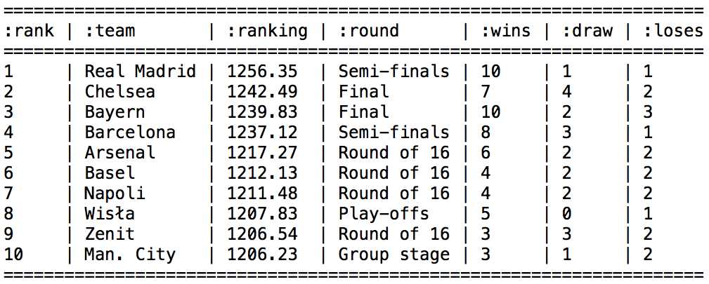
Did Chelsea deserve to win?

Slide 53
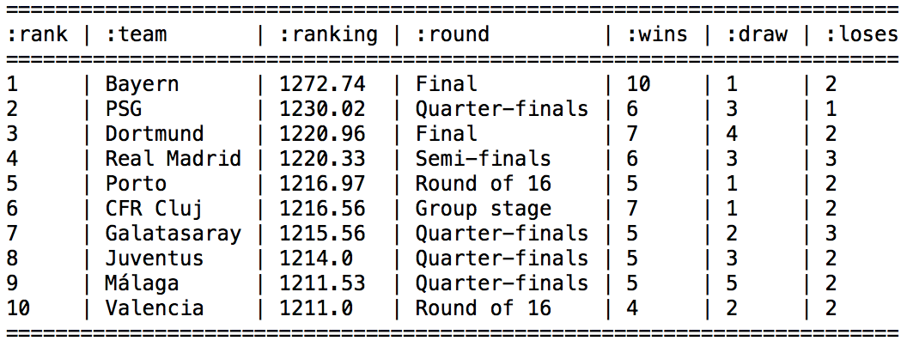
Where are Barcelona?
Notes:
Barcelona are missing, they won early games when everyone was closely ranked but then lost points late on
CFR Cluj end up so high because they won 2 dead rubbers

Slide 54
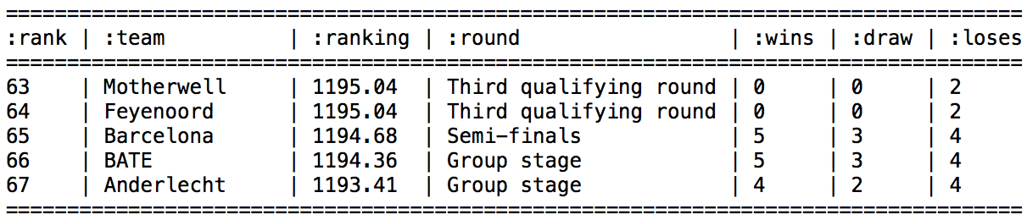
Where are Barcelona?
Notes:
Barcelona are missing, they won early games when everyone was closely ranked but then lost points late on

Slide 55
Everyone starts with the same base rating
Winning matters rather than making progress in the tournament
Ratings don’t change significantly game to game
Our “problems” so far
Notes:
Base rating – we put everyone at the same rating initially
Which means if you beat Barcelona right at the beginning
Then it’s the same as beating another weaker team

Slide 56
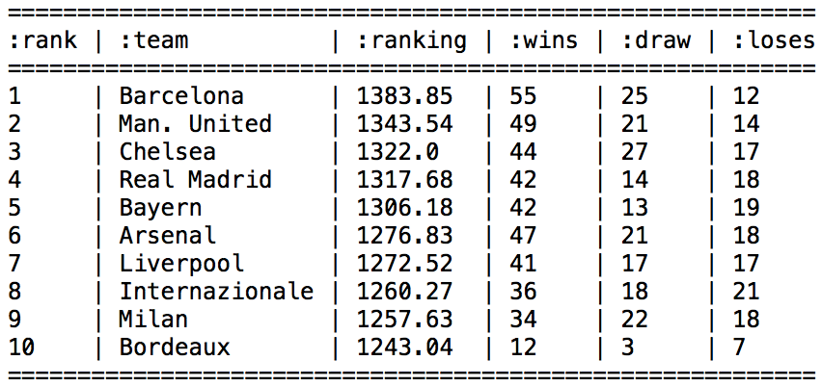
2004 - 2012
Notes:
We’ll build a base rating for teams from the previous 9 seasons
We include all the matches from 2004 until 2012 to get base ratings that we can use for 2012/2013
The ranking of some teams that didn’t even participate is higher than those that did!

Slide 57
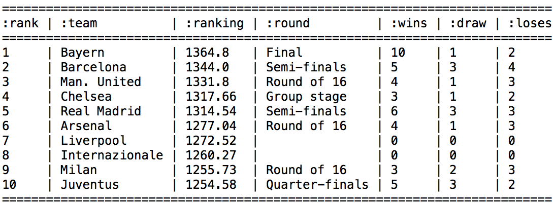
2004 - 2013
Notes:
Which means that for the teams participating in last year’s Champions League we end up with the following

Slide 58
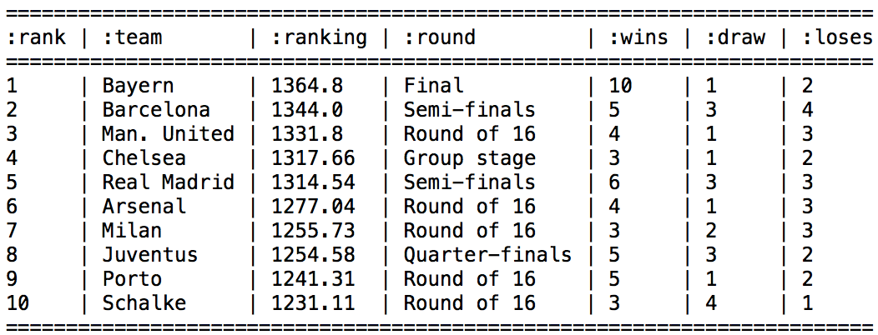
2012/2013 using 2004-2012 base ratings
Notes:
The ranking of some teams that didn’t even participate is higher than those that did!
Which means that for the teams participating in last year’s Champions League we end up with the following

Slide 59
New players can take a long time to ascend or descend to their correct levels.
Highly ranked players can be hesitant to play with provisional
There are no allowances for games with more than two players.
General problems with Elo
Notes:
We encounter number one but the other two don’t matter so much to us

Slide 60
“
The Glicko rating system is a method for assessing a player's strength in games of skill, such as chess and go.
It was invented by Mark Glickman as an improvement of the Elo rating system, and initially intended for the primary use as a chess rating system.
Glickman's principal contribution to measurement is "ratings reliability", called RD, for ratings deviation.
”
Glicko Rating System
Notes:
The first one applies to us – we need to run it over a few seasons worth of matches to get accurate rankings

Slide 61
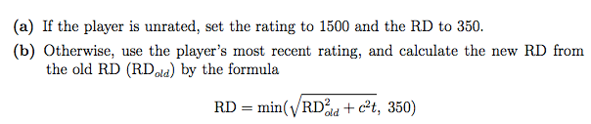
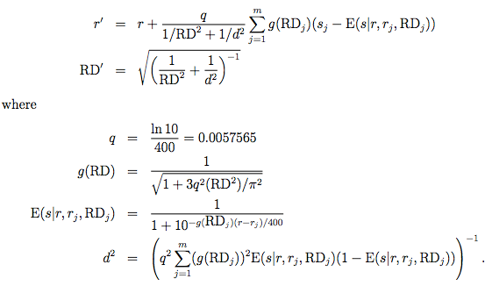
1)
2)
The Glicko Algorithm
Notes:
The first one applies to us – we need to run it over a few seasons worth of matches to get accurate rankings

Slide 62
Set a base ranking/RD for each team
Find the matches each team played in one season
Iterate over each team and update their ranking/RD based on those matches
And in English
Notes:
This is what the code looks like

Slide 63
(defn ranking-after-round [{ ranking :ranking rd :ranking-rd opponents :opponents}]
(+ ranking
(* (/ q
(+ (/ 1 (math/expt rd 2))
(/ 1 (d2 (map (partial g-and-e ranking)
opponents)))))
(reduce update-ranking
0
(map #(assoc-in % [:ranking] ranking)
opponents)))))
(def q (/ (java.lang.Math/log 10) 400))
(defn d2 [opponents]
(/ 1 (* (math/expt q 2)
(reduce process-opponent 0 opponents))))
(defn process-opponent [total opponent]
(let [{:keys [g e]} opponent]
(+ total
(* (math/expt g 2) e (- 1 e)))))
(defn g-and-e [ranking {o-rd :opponent-ranking-rd o-ranking :opponent-ranking}]
{:g (g o-rd) :e (e ranking o-ranking o-rd)})
(defn e [rating opponent-rating opponent-rd]
(/ 1
(+ 1 (math/expt 10 (/ (* (- (g opponent-rd)) (- rating opponent-rating)) 400)))))
(defn g [rd]
(/ 1 (java.lang.Math/sqrt (+ 1 (/ (* 3 (math/expt q 2) (math/expt rd 2))
(math/expt ( . Math PI) 2))))))
The algorithm in code
Notes:
This is what the code looks like

Slide 64
> (ranking-after-round { :ranking 1500
:ranking-rd 200
:opponents
[{:opponent-ranking 1400 :opponent-ranking-rd 30 :score 1}
{:opponent-ranking 1550 :opponent-ranking-rd 100 :score 0}
{:opponent-ranking 1700 :opponent-ranking-rd 300 :score 0}]})
1464.1064627569112
> (ranking-after-round { :ranking 1500
:ranking-rd 200
:opponents
[{:opponent-ranking 1400 :opponent-ranking-rd 30 :score 1}
{:opponent-ranking 1550 :opponent-ranking-rd 100 :score 0}
{:opponent-ranking 1200 :opponent-ranking-rd 50 :score 0}]})
1384.1856308208341
The algorithm in code
Notes:
This is what the code looks like

Slide 65
(defn rd-after-round
[{ ranking :ranking rd :ranking-rd opponents :opponents}]
(java.lang.Math/sqrt (/ 1
(+ (/ 1 (math/expt rd 2))
(/ 1
(d2 (map (partial g-and-e ranking)
opponents)))))))
> (rd-after-round {:ranking 1500 :ranking-rd 200 :opponents
[{:opponent-ranking 1400 :opponent-ranking-rd 30 :score 1}
{:opponent-ranking 1550 :opponent-ranking-rd 100 :score 0}
{:opponent-ranking 1700 :opponent-ranking-rd 300 :score 0}]})
151.39890244796933
The algorithm in code
Notes:
This is what the code looks like

Slide 66
(defn process-team
[team ranking matches]
(let [rankings
(glicko/initial-rankings (uefa/extract-teams matches))
opponents
(map glicko/as-glicko-opposition
(show-opponents team matches rankings))]
(-> ranking
(update-in
[:points]
#(glicko/ranking-after-round
{ :ranking %
:ranking-rd (:rd (get rankings team))
:opponents opponents}))
(update-in
[:rd]
#(glicko/rd-after-round
{ :ranking (:points (get rankings team))
:ranking-rd %
:opponents opponents})))))
(defn update-team
[matches rankings team]
(assoc-in rankings [team] (process-team team (get rankings team) matches)))
Wiring it all together
Notes:
This is what the code looks like

Slide 67
> (def matches [{:home "Man. United",
:away "Man. City",
:home_score 7,
:away_score 0}])
> (def teams {"Man. United" {:points 1400 :rd 50},
"Man. City" {:points 1600 :rd 100}})
> (update-team matches teams "Man. United")
{"Man. United" {:points 1595.2766454319408,
:rd 49.76982046859493},
"Man. City" {:points 1600.0,
:rd 100.0}}
> (update-team matches teams "Man. City")
{"Man. United" {:points 1400,
:rd 50},
"Man. City" {:points 1404.7233545680592,
:rd 98.19579824070357}}
Wiring it all together
Notes:
So we do each team individually and go across the matches each time

Slide 68
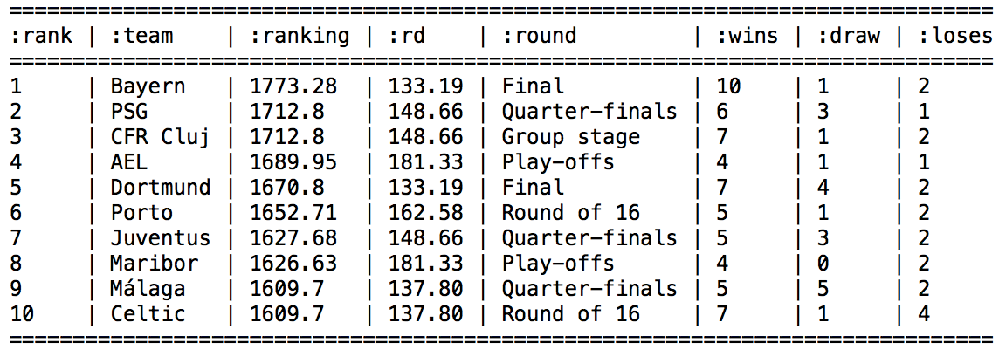
2012/2013 with a season as rating period
Notes:
This means that each opponent is the same because they all have a 1500/350 ranking/rd.
Doesn’t take the difficulty of opponent into account at all

Slide 69
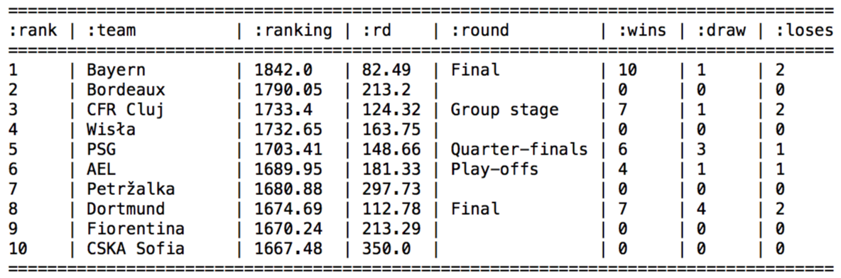
2004-2013
Notes:
Here we apply Glicko over all the seasons – one way that the chess guys use the RD value is to exclude teams over a certain value

Slide 70
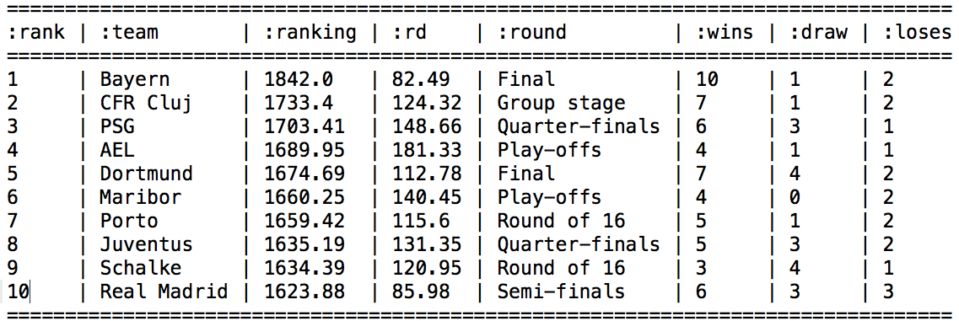
2004-2013
Notes:
This is Glicko if we only include the teams that played this season – this one gives a lot of credit for winning games and the early qualifying games seem to distort because they all have the same impact

Slide 71
Difficult to know if the algorithm is working
Glicko places a big emphasis on winning games
Wins in qualifying rounds distort rankings
Both algorithms are more accurate when lots of games are played
Thoughts and Observations
Notes:
I still haven’t quite worked out how to use these to properly rank teams

Slide 72
Should we penalise qualifiers so those matches don’t have such an impact on ranking?
Can you have a pure ranking system if the competition setup is subjective?
Can we separate long running ranking vs current winning streak?
Questions to think about

Slide 73
Can humans handle objectivity?
And one final question
Notes:
I found while looking through the rankings that I believed them to be ‘wrong’. Barcelona should be the best!

Slide 74
Glicko 2
Harkness
True Skill
eGenesis
USATT
Matrix Based Algorithms
Other Ranking Systems
Notes:
Glicko 2 – adds a volatility score which allows us to set a more accurate ranking for people depending on whether they are achieving erratic or stable results - http://chess.stackexchange.com/questions/1260/glicko-2-rating-system-bug-or-exploit
Harkness – originally used for chess. Used a simpler algorithm by averaging the opponents ranking and then adjusts your ranking based on that, not taking current one into account
True Skill – used by Microsoft for Xbox Live rankings (http://research.microsoft.com/en-us/projects/trueskill/)
eGenesis – designed to reduce the impact of cheating by creating fake players - http://chronx.com/live/index.php?topic=739.0
USATT – used for table tennis rankings. Similar to Elo but also takes uncertainty into account
Perron Frobenius Theorem & The Ranking of football teams - https://umdrive.memphis.edu/ccrousse/public/MATH%207375/PERRON.pdf

Slide 75
Code & Talk:
https://github.com/mneedham/ranking-algorithms
http://bit.ly/rankings-dsldn
Me:
@markhneedham
http://www.markhneedham.com/blog/category/ranking-systems-research/
And that’s it
Notes:
Harkness – originally used for chess. Used a simpler algorithm by averaging the opponents ranking and then adjusts your ranking based on that, not taking current one into account
True Skill – used by Microsoft for Xbox Live rankings (http://research.microsoft.com/en-us/projects/trueskill/)
eGenesis – designed to reduce the impact of cheating by creating fake players - http://chronx.com/live/index.php?topic=739.0
USATT – used for table tennis rankings. Similar to Elo but also takes uncertainty into account
Perron Frobenius Theorem & The Ranking of football teams - https://umdrive.memphis.edu/ccrousse/public/MATH%207375/PERRON.pdf

